Slide 1
Association of Estonian Cities
Fostering the Development of Decentralised Public Administration

Slide 2
Local Self-Government in Estonia
215 (226) local self-government entities in total
- 30 (33) cities
- 185 (193) rural municipalities
1993: Administrative-territorial reform
  One-layer local government system

Slide 3
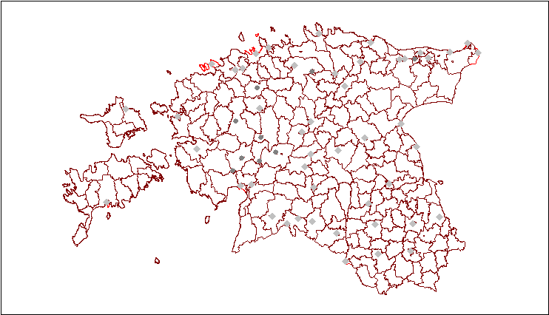
Local government entities

Slide 4
Population in local authorities
Population | Cities | Rural municipalities | Total
0-1 000 | 2 | 36 | 38
1001-1500 | 1 | 43 | 44
1 501-2 000 | 1 | 29 | 30
2 001-3 000 | 3 | 27 | 30
3 001-4 000 | 1 | 12 | 13
4 001-5 000 | 3 | 14 | 17
5 001-7 500 | 4 | 13 | 17
7 501-10 000 | 2 | 5 | 7
10 001-20 000 | 8 | 6 | 14
20 001 - 50 000 | 2 | 0 | 2
50 001-100 000 | 2 | 0 | 2
100 001- | 1 | 0 | 1
KOKKU | 30 | 185 | 215

Slide 5
Population in local authorities
Population | Cities | Rural municipalities | Total
0-1 000 | 2 | 36 | 38
1001-1500 | 1 | 43 | 44
1 501-2 000 | 1 | 29 | 30
2 001-3 000 | 3 | 27 | 30
3 001-4 000 | 1 | 12 | 13
4 001-5 000 | 3 | 14 | 17
0 – 5 000 | 11 | 161 | 172
5 001-7 500 | 4 | 13 | 17
7 501-10 000 | 2 | 5 | 7
10 001-20 000 | 8 | 6 | 14
20 001 - 50 000 | 2 | 0 | 2
50 001-100 000 | 2 | 0 | 2
100 001- | 1 | 0 | 1
TOTAL | 30 | 185 | 215

Slide 6
Population in local authorities
Smallest: 99 persons
Biggest: 430 026 persons
Average: 6318 persons (6010)

Slide 7
Population in local authorities
Smallest: 99 persons
Biggest: 430 026 persons
Median: 1908 persons (1763)

Slide 8
Local authorities perform the same functions irrespective of their size
The total amount of their expenses in 2011 on cash basis was 1 296 million euros.
Operating expenses comprised 72% of this.

Slide 9
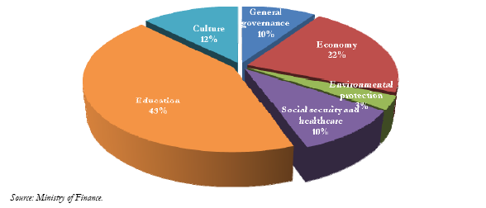
Division of the expenditure of local authorities by areas of activity in 2011
The budgets of local authorities are independent, which means that they prepare them themselves. Their main types of revenue are income tax and support from the state budget.
Education 43%
Environmental protection 3%
Social security and healthcare 10%

Slide 10
Municipal cooperation in Estonia
What is the overall setup (environment) for municipal cooperation
Is it supportive or not, is the cooperation
made easy or not
Some examples of different kinds of cooperation

Slide 11
The overall setup (environment)
Local Government Organisation Act
Chapter 10
CO-OPERATION OF LOCAL GOVERNMENTS
For the expression, representation and protection of common interests and for the performance of common functions, rural municipalities and cities may:
1) co-operate;
2) grant authority to another rural municipality or city for this purpose;
3) form local government associations and other organisations.

Slide 12
The overall setup (environment)
Local Government Organisation Act
Chapter 10
CO-OPERATION OF LOCAL GOVERNMENTS
For the expression, representation and protection of common interests and for the performance of common functions, rural municipalities and cities may:
1) co-operate;
2) grant authority to another rural municipality or city for this purpose;
3) form local government associations and other organisations.

Slide 13
3) form local government associations and other organisations
There is no obligation to co-operate in any field
The most usual way for cooperation – to form non-profit organisation (local gov’t association is also non-profit organisation)

Slide 14
Multi-municipal cooperation can help
save money
reduce duplication
provide better quality service for communities

Slide 15
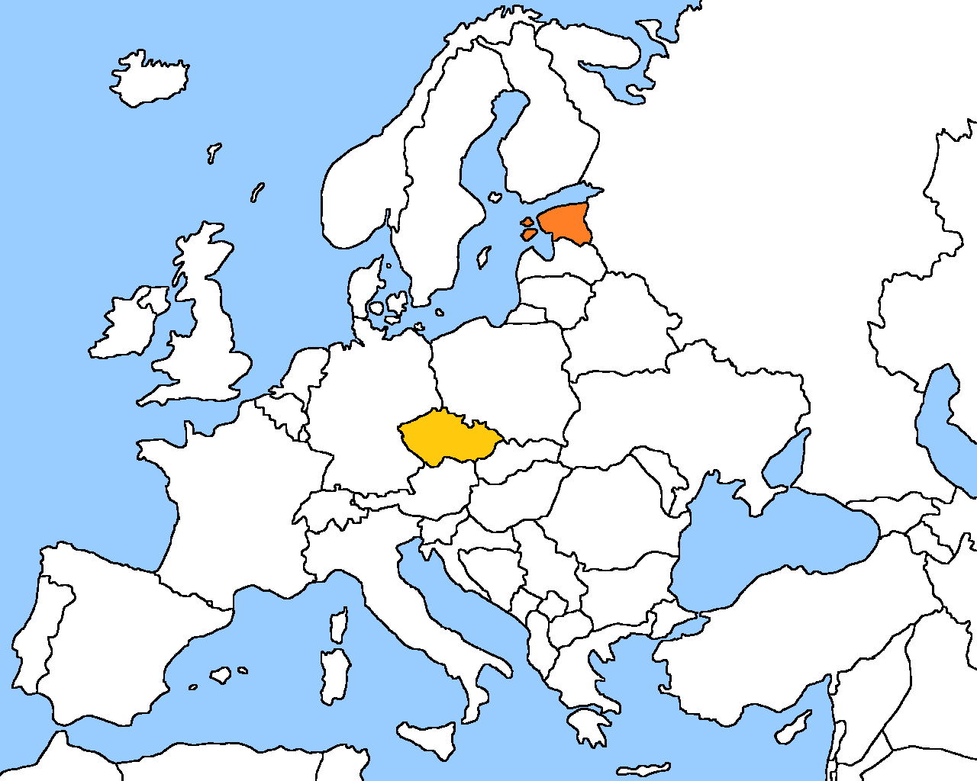

Slide 16
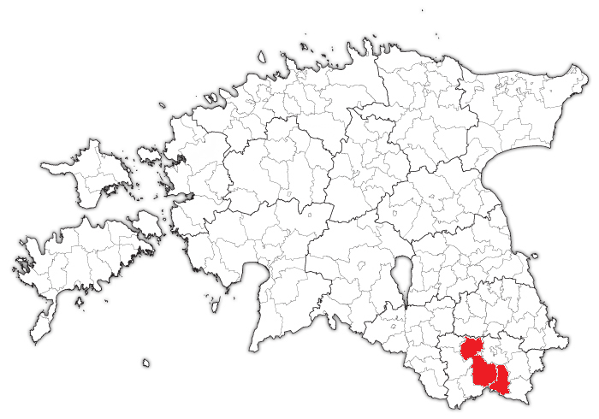

Slide 17
Childcare services for the persons having disabled children;
individual counselling, operative employment mediation to the economically un-favoured people;
aimed at people who are away from the labour market.
To bring people to the labour market
/EU financed/

Slide 18
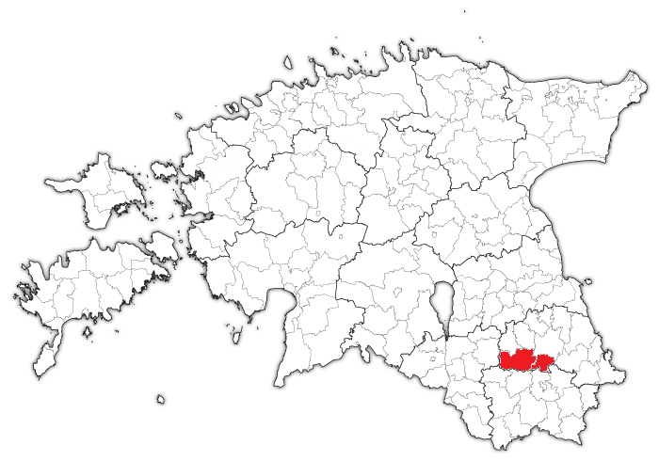

Slide 19
Personal assistants to the
- Persons with learning disabilities
- Children and young people from violent families
- People with disabilities
- Drug addicts
- Persons released from prison
To bring people to the labour market
Public and NGO cooperation
/EU financed/

Slide 20
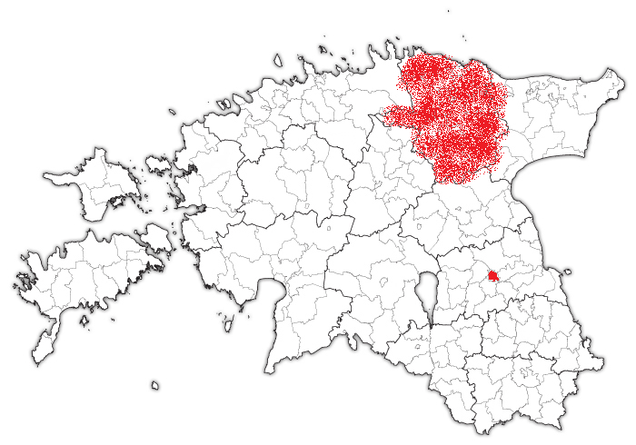

Slide 21
Social transport
Access to public services (health services, pharmacy services, financial services, legal services, and social services);
Access to educational institution, or to work and back home;
To serve the basic needs (including shopping, beauty services, recreation, etc.)
/EU financed 2011-2012/

Slide 22
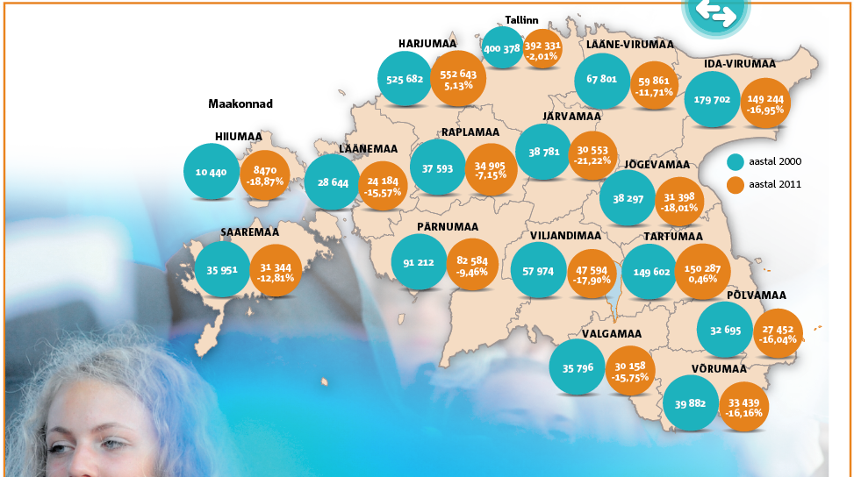
Population and Housing Censuses in Estonia 2000 vs 2012

Slide 23
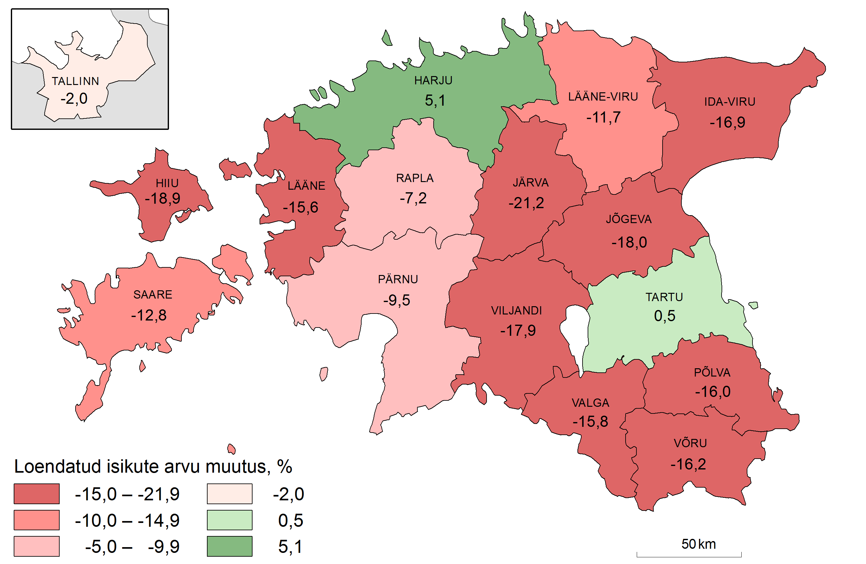
Census 2000 vs 2012

Slide 24
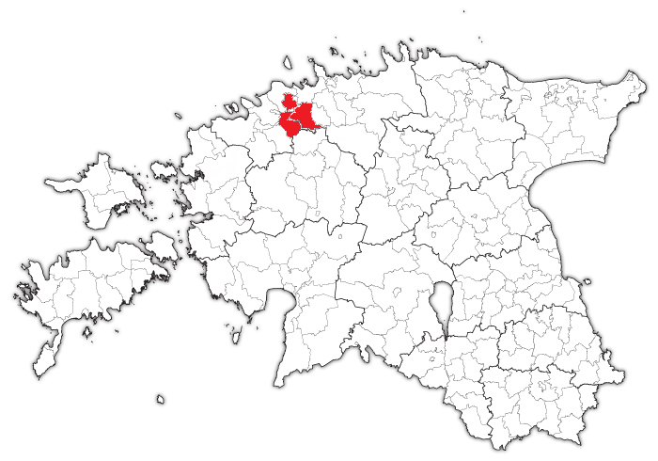

Slide 25
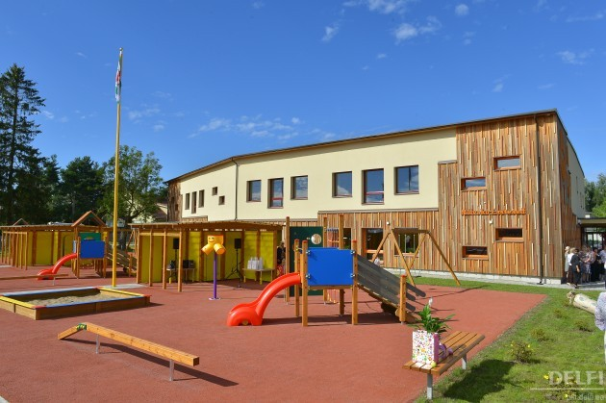
Kindergarten
Funded by two municipalities
Nearly zero energy building
Photo: delfi.ee

Slide 26
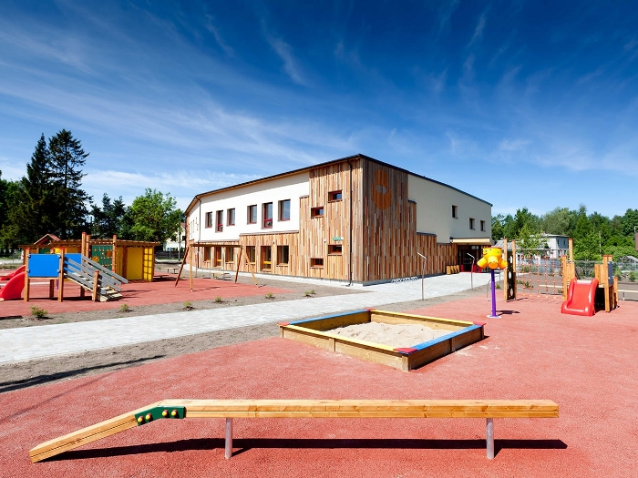
Photo: kaldram.ee

Slide 27
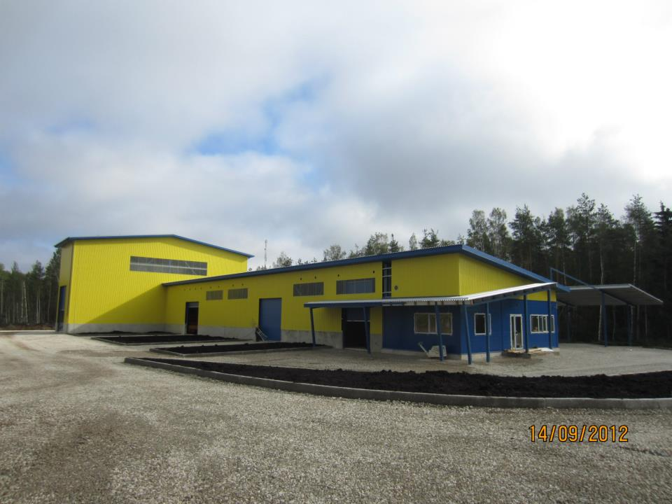
Recycling Centers
Almost every county has it
NGO, all municipalities participate
A place for waste recycling and mana-
gement

Slide 28
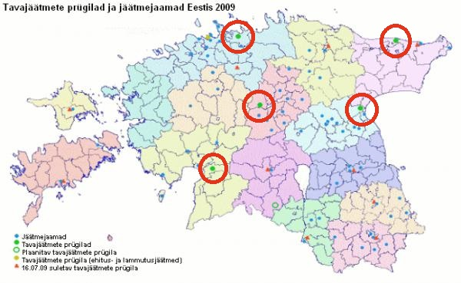
Landfills

Slide 29
Internet and communication technology
Cooperation between municipalities? The overall setup - most of the services are connected to the state registers and exchange of municipal data goes via state systems.
Has saved a lot of money to the municipalities!

Slide 30
Internet and communication technology
X-road, introduced in 2001
There are around 400 municipal and state services integrated, and more are coming.

Slide 31
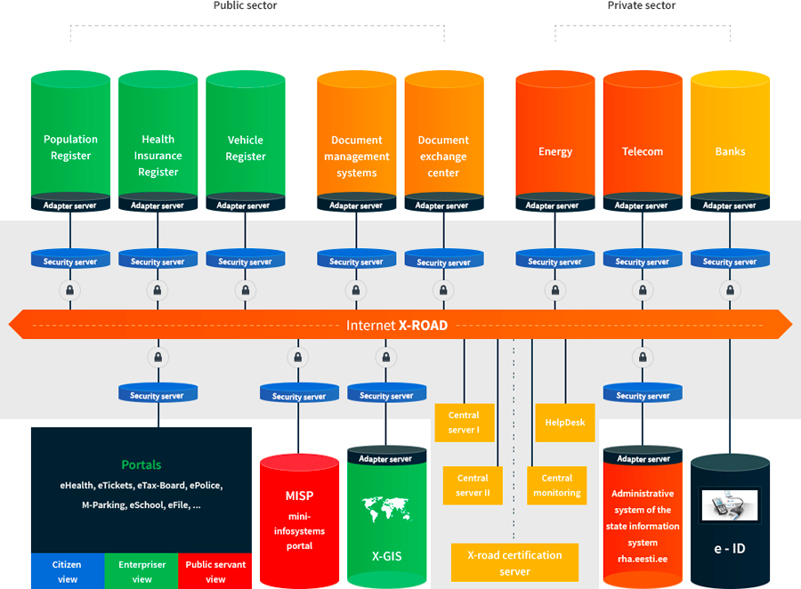

Slide 32
Multi-municipal cooperation can help
save money. Whose money?
Let’s see…

Slide 33

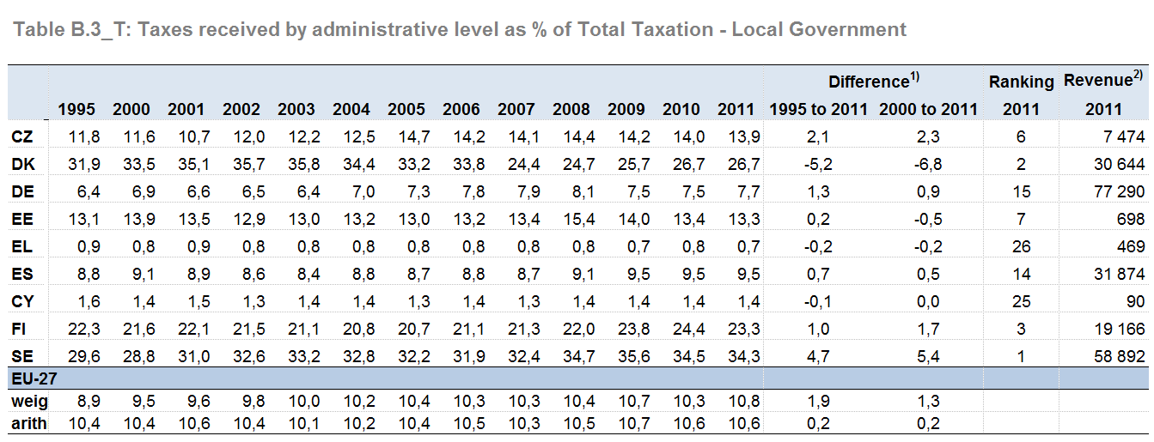
Taxation trends in the European Union
2013 edition

Slide 34
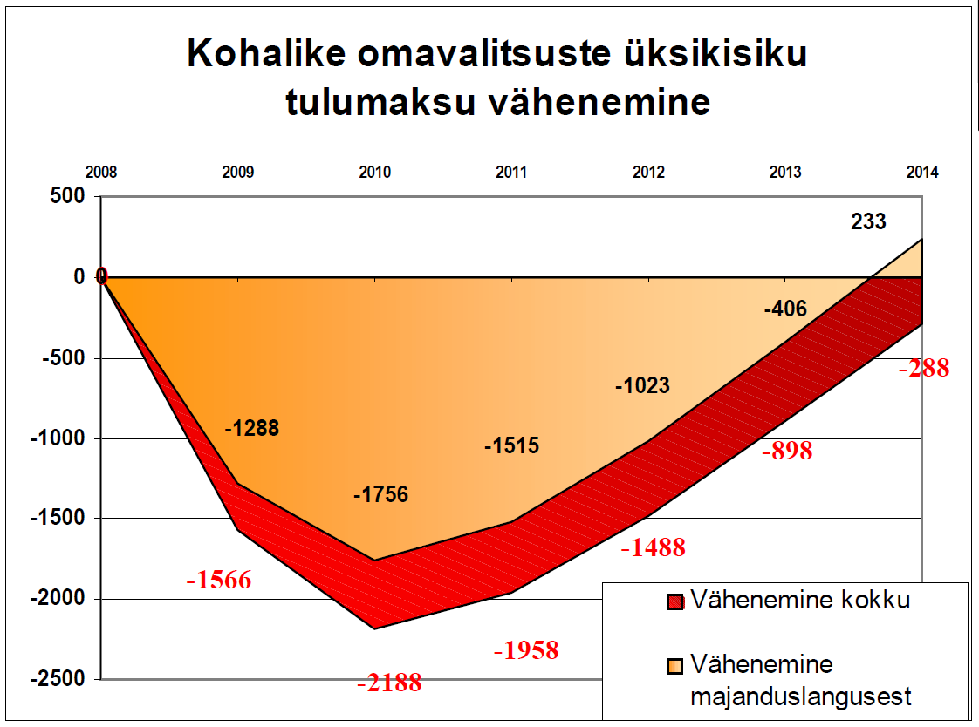
Current issues
Decrease of Personal Income Tax
to local budgets (MEEK)
Total decrease
Decrease caused by the recession

Slide 35
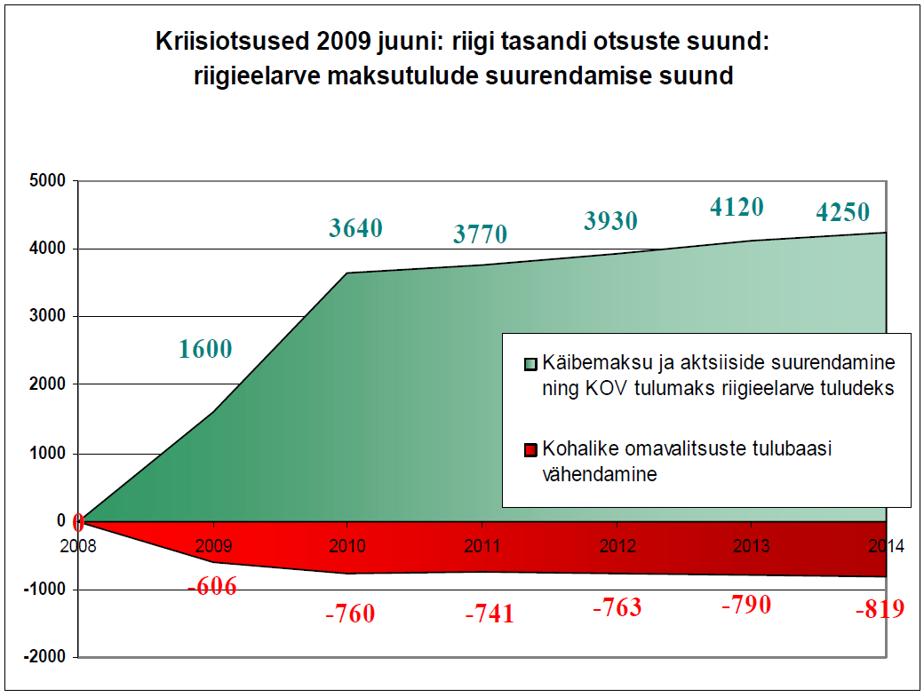
Crisis-management in June 2009, state decisions: to increase the national taxes (MEEK)
Increasing VAT and access taxes, bigger share of PIT to state pubget
Decrease of local income base

Slide 36
Last remarks (1/2)
EU money drives the cooperation in many (most) cases
Via lobbying you can get money easily, so why should municipality think of saving it via the cooperation? (Multi-municipal cooperation can help save money…)

Slide 37
Last remarks (2/2)
Central gov’t can easily intervene to local finances, no real incentive to co-operate in order to save
„My money stays in my municipality“ (money=power (to make decisions)

Slide 38
Thank you!

