Slide 1

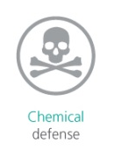



GUARDIAN2 Air Quality Monitoring System

Slide 2






Indoor/Outdoor applications

Slide 3

Multi-parameter
Nitrogen Oxides (NO, NO₂)
Carbon Mono-Dioxides (CO, CO₂)
Sulfur Dioxide (SO₂)
Methane (CH₄)
Ozone (O₃)
Chlorides (Cl₂)
Formaldehyde (HCHO)
Ammonia (NH₃)
Hydrogen sulfide (H₂S)
Total VOC
Oxigen (O₂)
PM10, PM2.5, PM1
Noise
Meteorological parameters

Slide 4
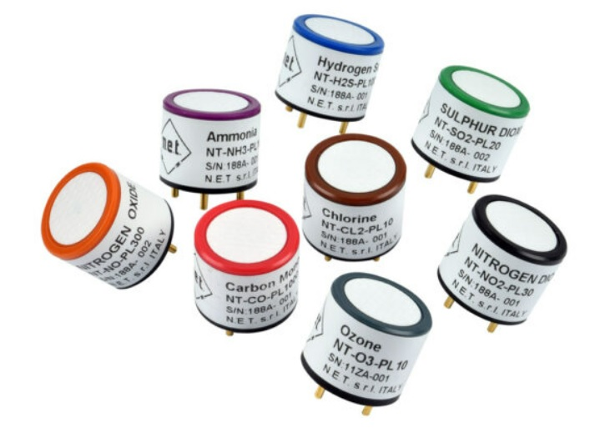
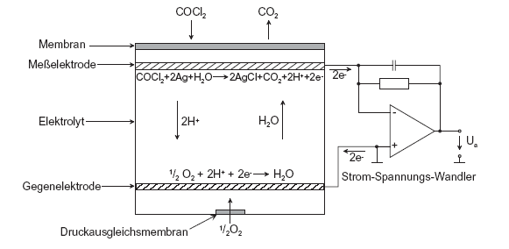
Gases
Sensor type: Electrochemical Cell
Substance | Detection Range
NO₂ | 0 - 30 ppm
SO₂ | 0 - 100 ppm
CO | 0 - 1000 ppm
CO₂ | 0 - 5000 ppm
CH₄ | 0 - 50 ppm
NH₃ | 0 - 100 ppm
H₂S | 0 - 100 ppm
VOC | 0 - 10 ppm
O₃ | 0 - 10 ppm

Slide 5
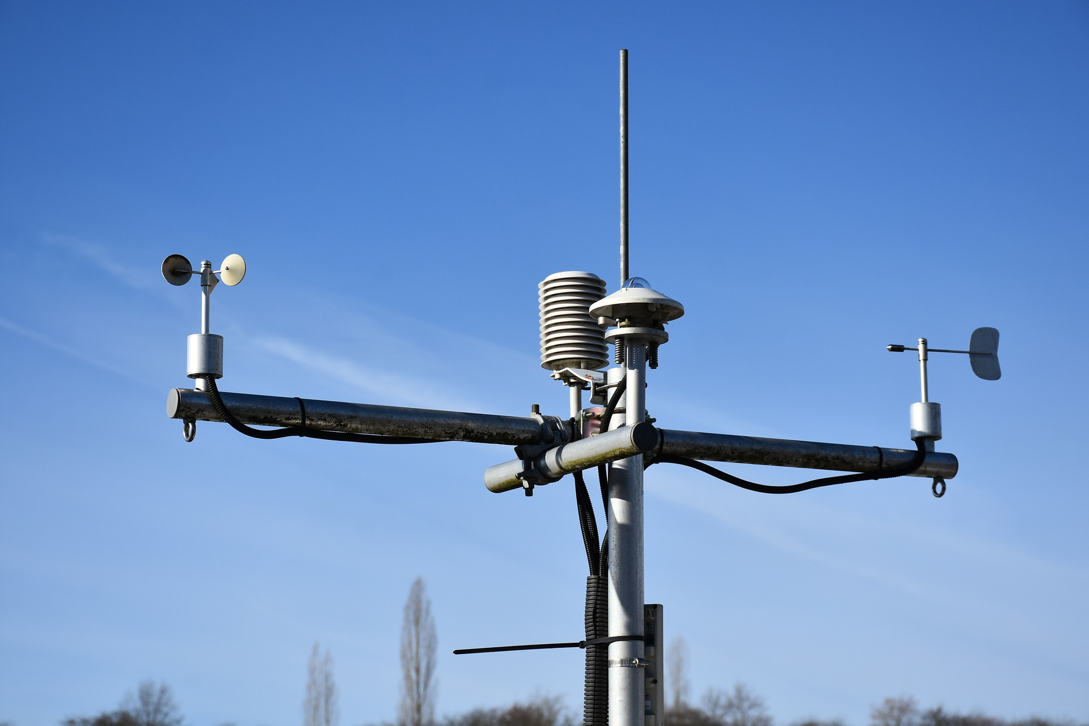
Weather / PMx / Noise
Sensor Type: Meteorological Sensors + Optical Particle Counter + Phonometer
Wind speed/direction
Temperature
Humidity
Pressure
Solar radiation
UV radiation – UV index
Rainfall – snowfall
PM10, PM2.5, PM1
Noise

Slide 6
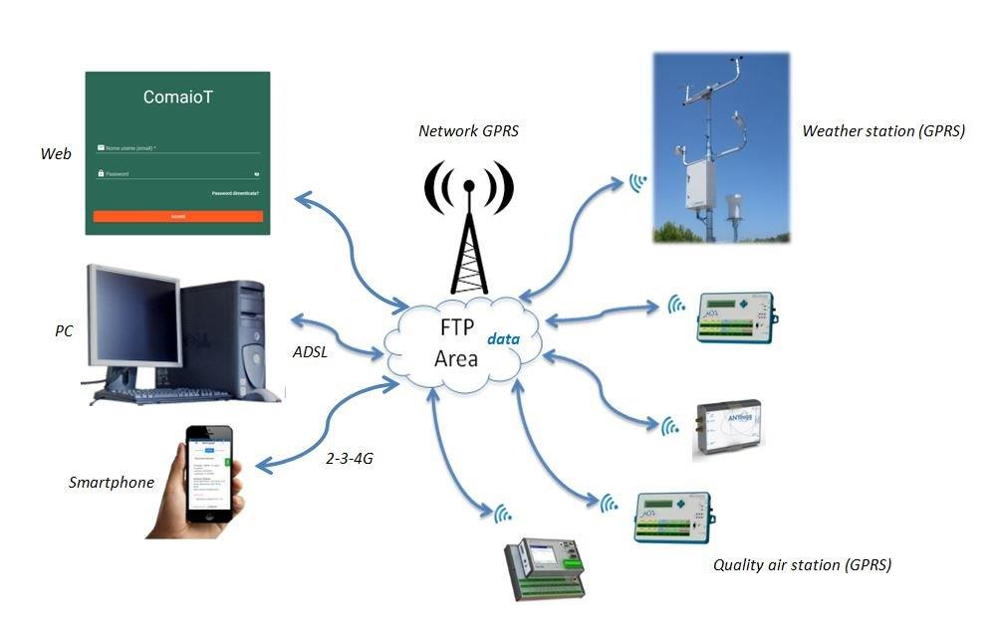
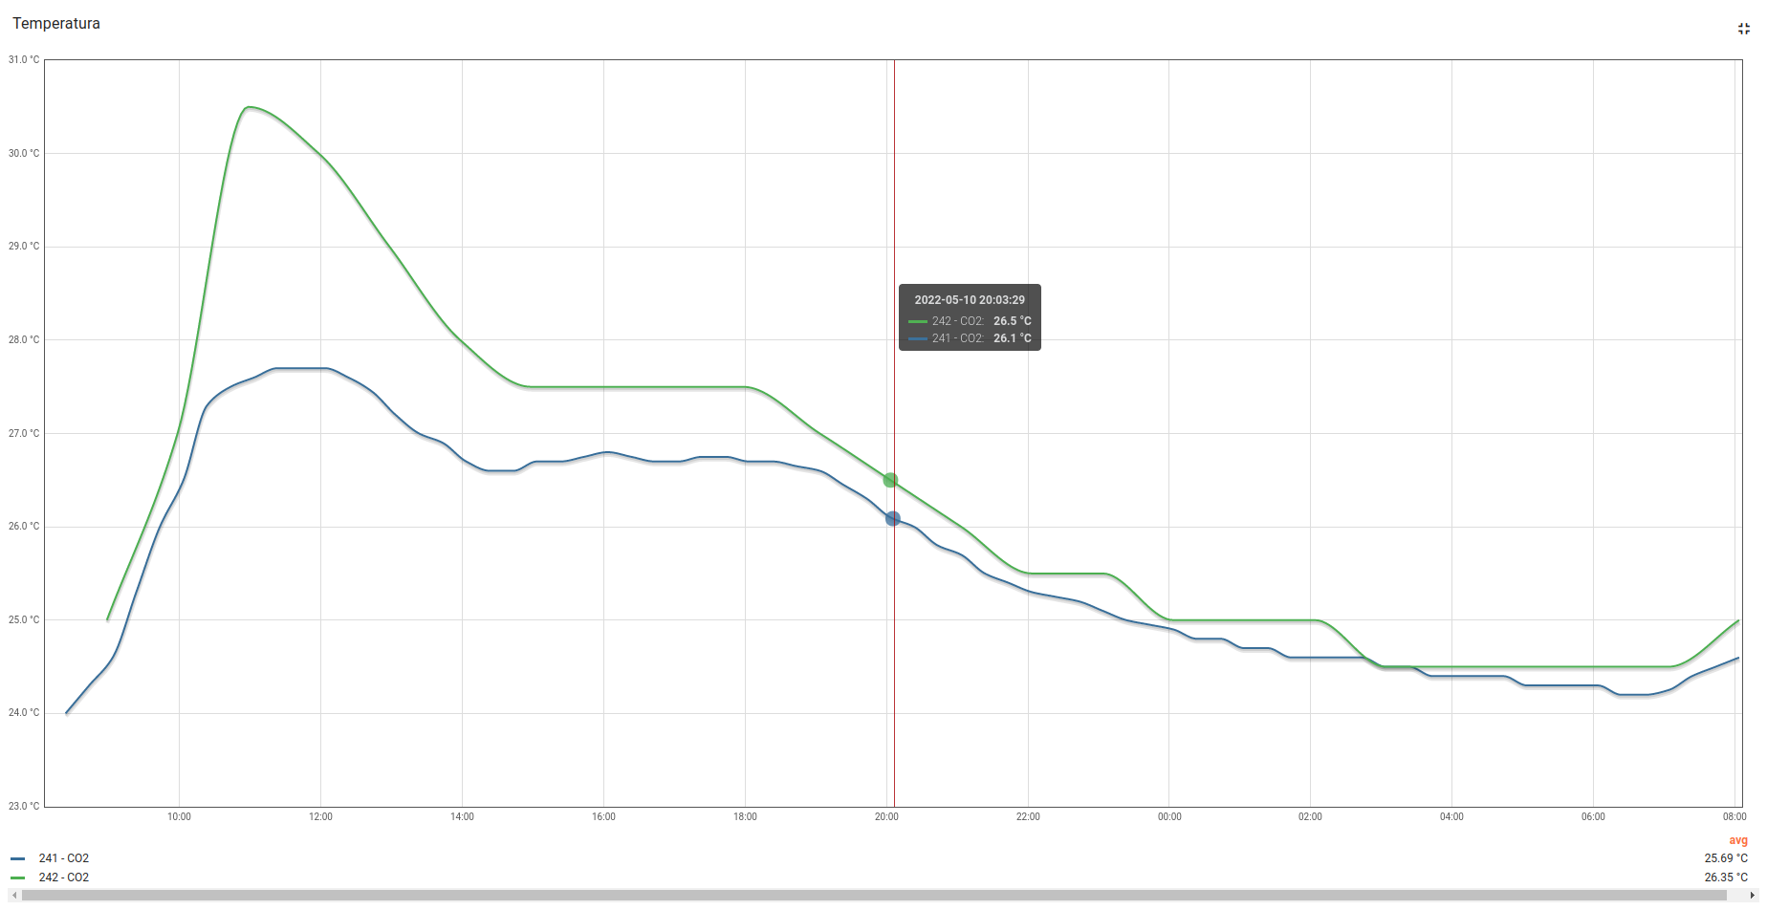
Guardian2 Network
WEB Platform
GRPS
Weather stations
WEB Platform
Smartphone APP
Air Quality Stations

Slide 7

Data Management
WEB Platform
Smartphone APP
Android 9.0 (PIE) and superior
Set concentration thresholds
Alarms

Slide 8
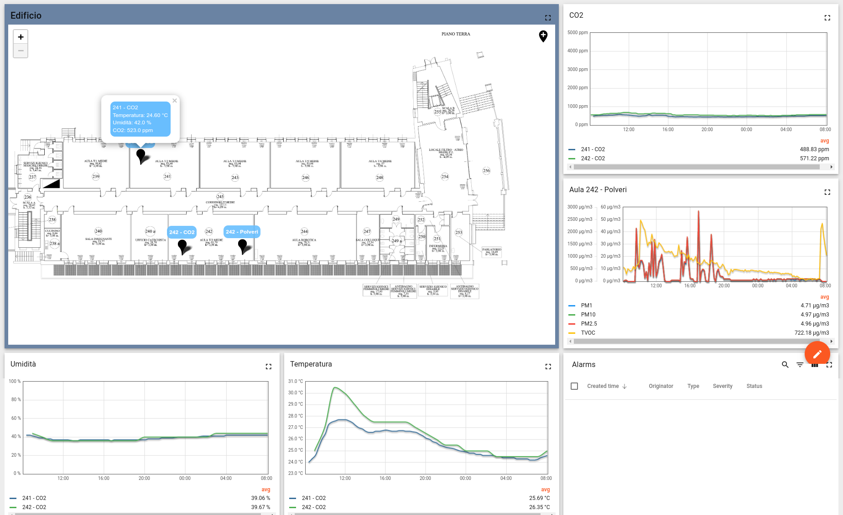
Building S4
CO₂
Elementary school:
CO₂
VOC
PMx
Temp.
RH%
Rh%
Temperature

Slide 10

Thank you for your attention

