Slide 1

OLFOSENSE
Instrumental Odor Monitoring System

Slide 2
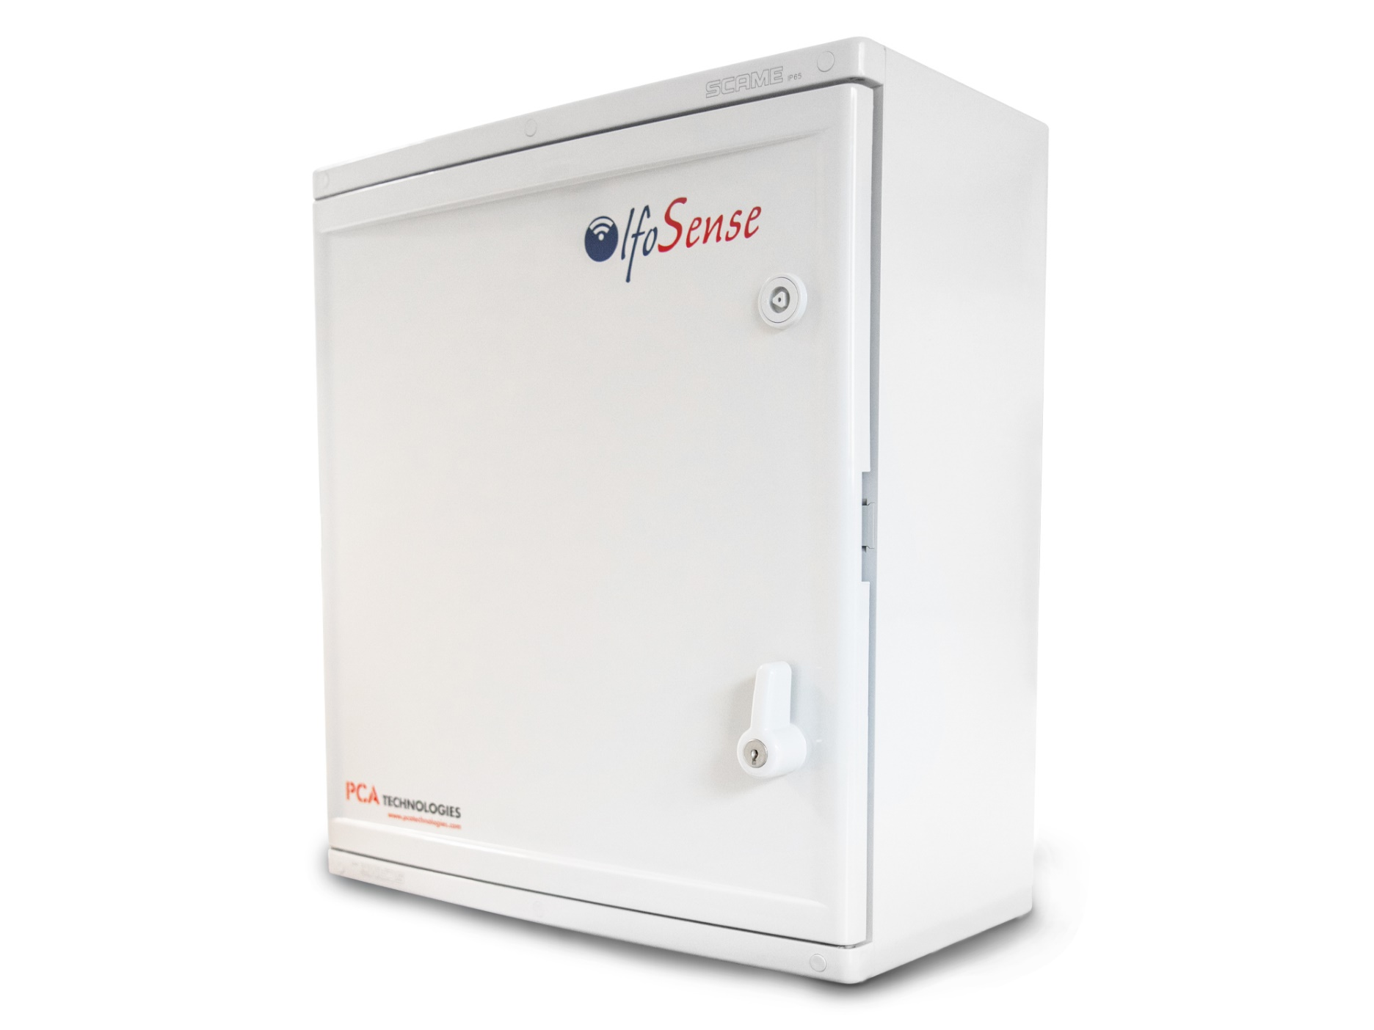
Multi-parameter
Odor (Olfactometric Units - OU_{E}/m³)
Total VOC (ppb)
NH₃ & H₂S (ppb)
PM10 - PM2.5 - PM1 (µg/m³)
Weather parameters
Dispersion modeling

Slide 3
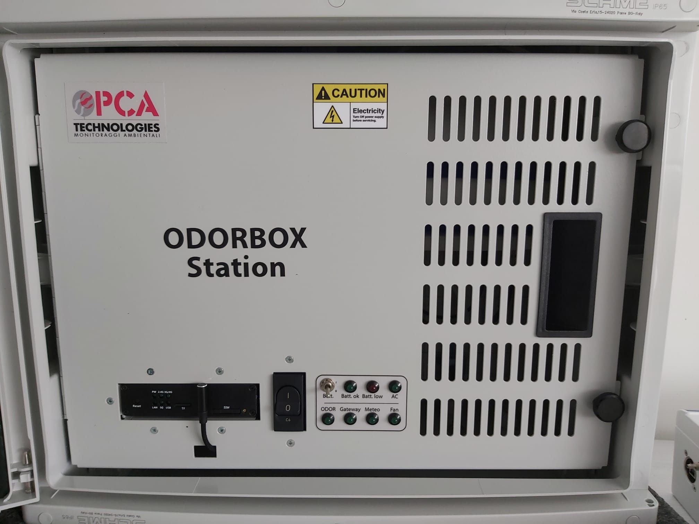
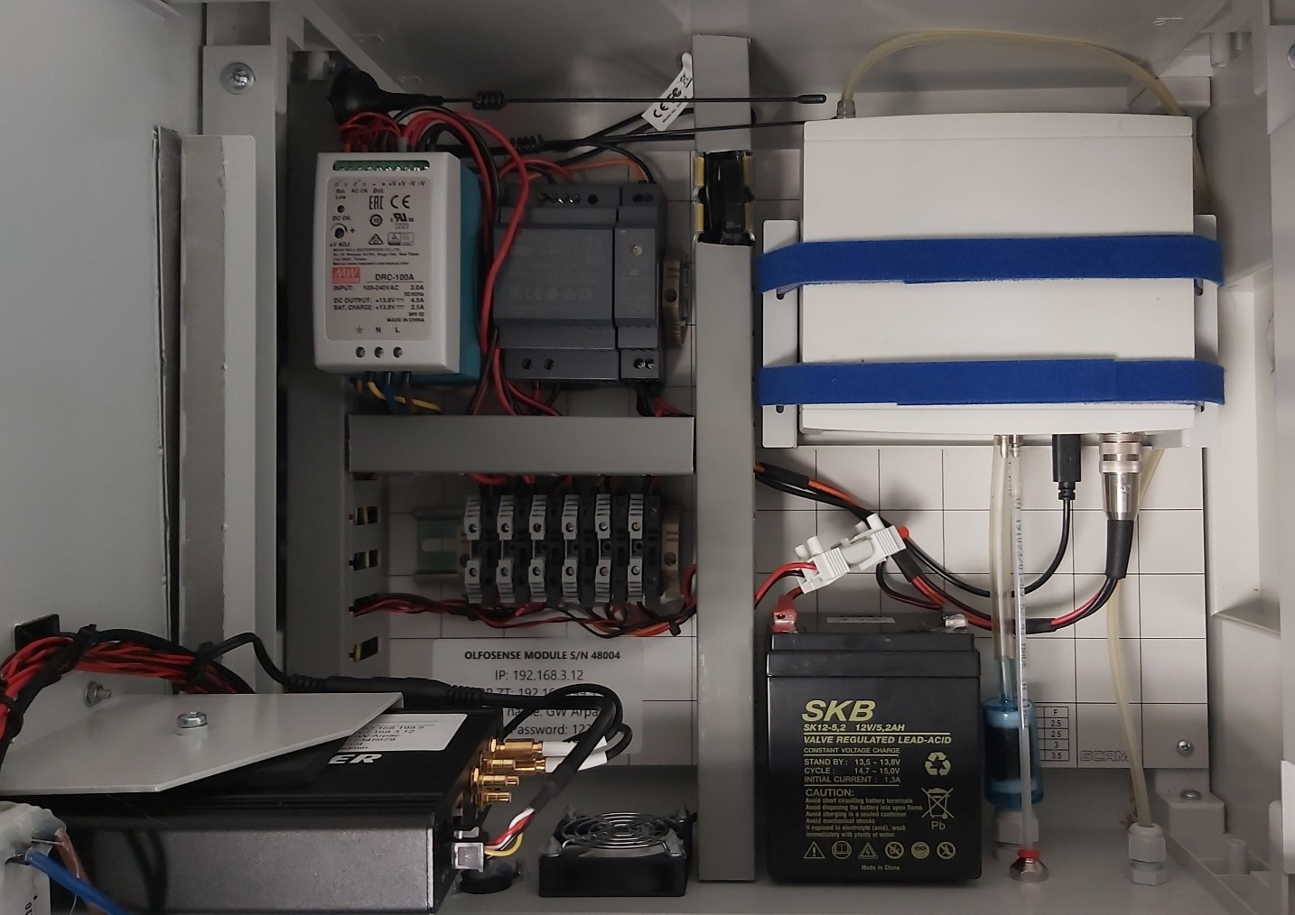
Module
MOS
PID
2XECD
Gateway
UMTS
Data local storage
Charcoal filter
Zero air

Slide 4

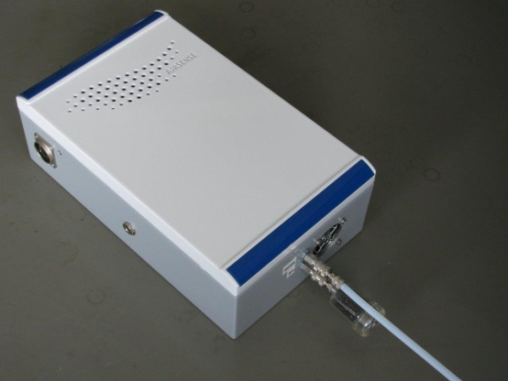
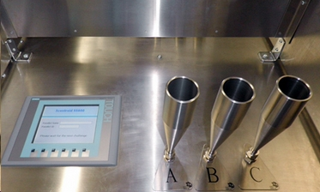
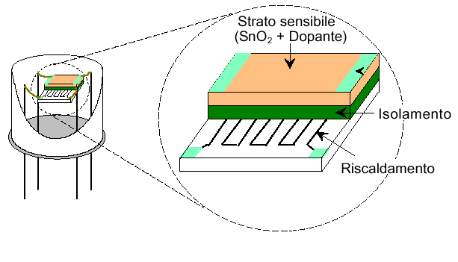
Odor Measurement
Metal Oxide Semiconductors
Standard algorithm
(nbutanol gas)
OlfoSense MOS Array
Dynamic Olfactometry
Prediction
ODOR UNITS / m³

Slide 5

Calibration for Odor measurement
On-site algorithm
On-site samples
Prediction
OU / m³

Slide 6
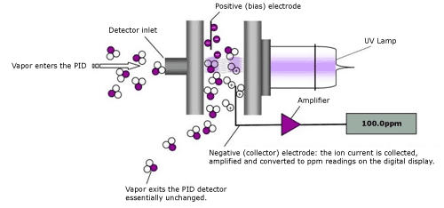
VOC Measurement
PID (PhotoIonization Detector) 10.6 eV
RANGE: 5 ppb - 20 ppm
CAPABILITY: ̴320 compounds
CALIBRATION: Isobutylene

Slide 7
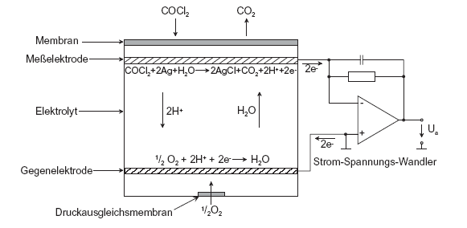
H₂S - NH₃ measurements
Electrochemical cell
RANGE:
H₂S = 5 ppb – 50 ppm
NH₃ = 5 ppb – 100 ppm
CALIBRATION: NH₃ - H₂S
S compounds = petrochemical / anaerobic plants
Ammonia = aerobic plants

Slide 8

Data Management
Remote Control
Gateway: GPRS/UMTS
Cloud Server
OlfoClient platform
Local Storage
SD card

Slide 9




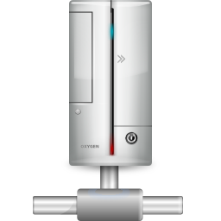



OlfoSense Network
OLFOCLIENT
CLOUD
OLFOSENSE
Database
Web Services

Slide 10

OlfoClient platform

Slide 11

OlfoClient
Secure access

Slide 12
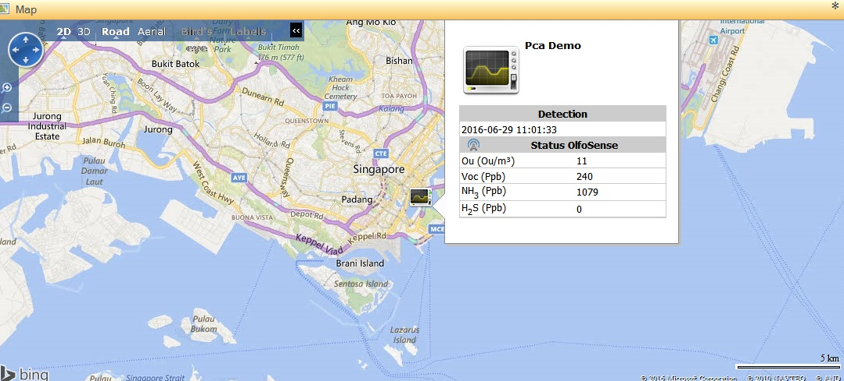
OlfoClient
Real-time overview
Live data

Slide 13
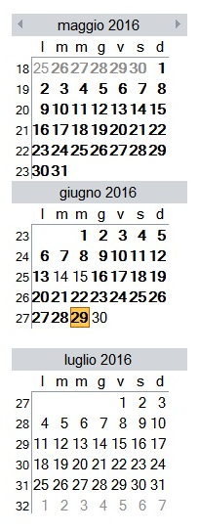
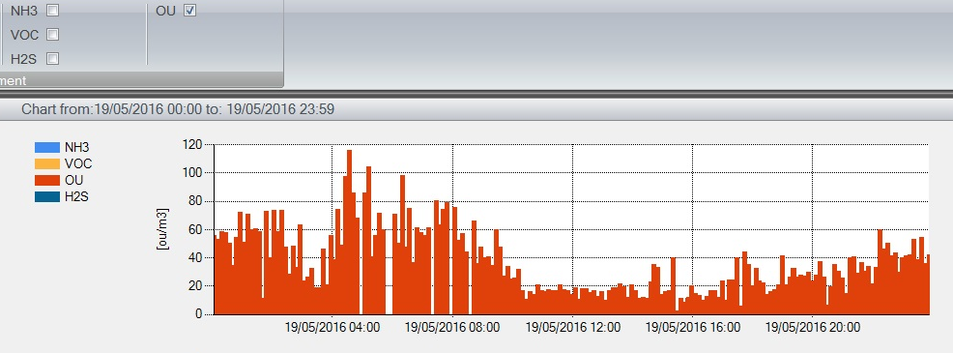
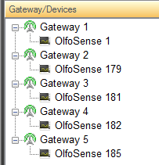
OlfoClient
Historical data: charts and tables
Select a date
or date range
Select a device

Slide 14
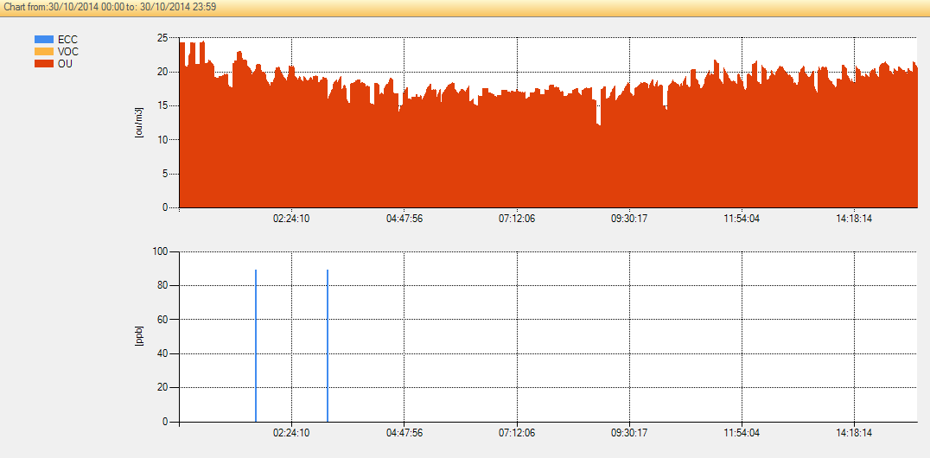
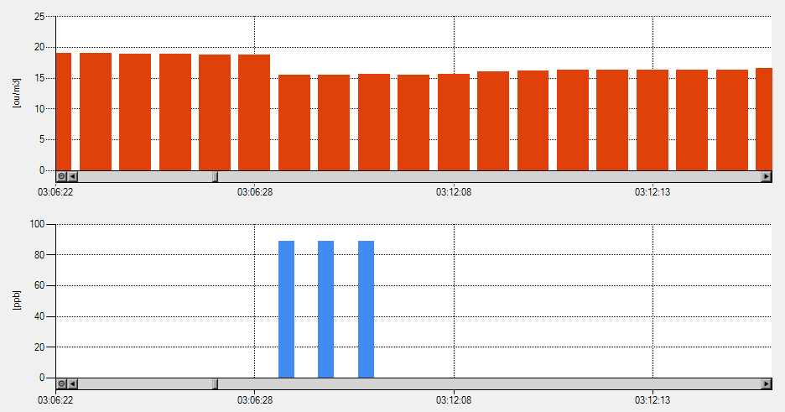
OlfoClient
Interactive analytics
Printable reports

Slide 15




OlfoClient
Device | Parameter | Rule | Limit (ppb)
Olfo 182 | OU | > | 800
Olfo 179 | VOC | > | 2500
ALARM

Slide 16

SMIT Olfo
Dispersion Modeling

Slide 17
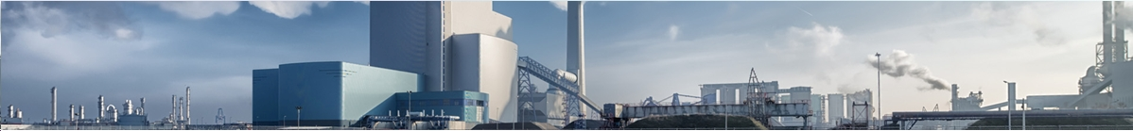
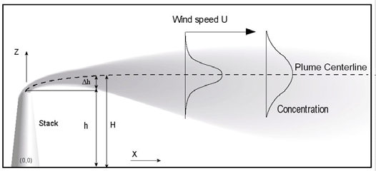
Input
FEATURES
ISC Aermod (US–EPA) dispersion model
Fallout plume of odorous compounds
Impact on sensitive receptors
Real-time impact assessment
OU/m³
Weather data
Terrain data
Process parameters
(elevation from the ground,
odor emission rate,
temperature…)

Slide 18
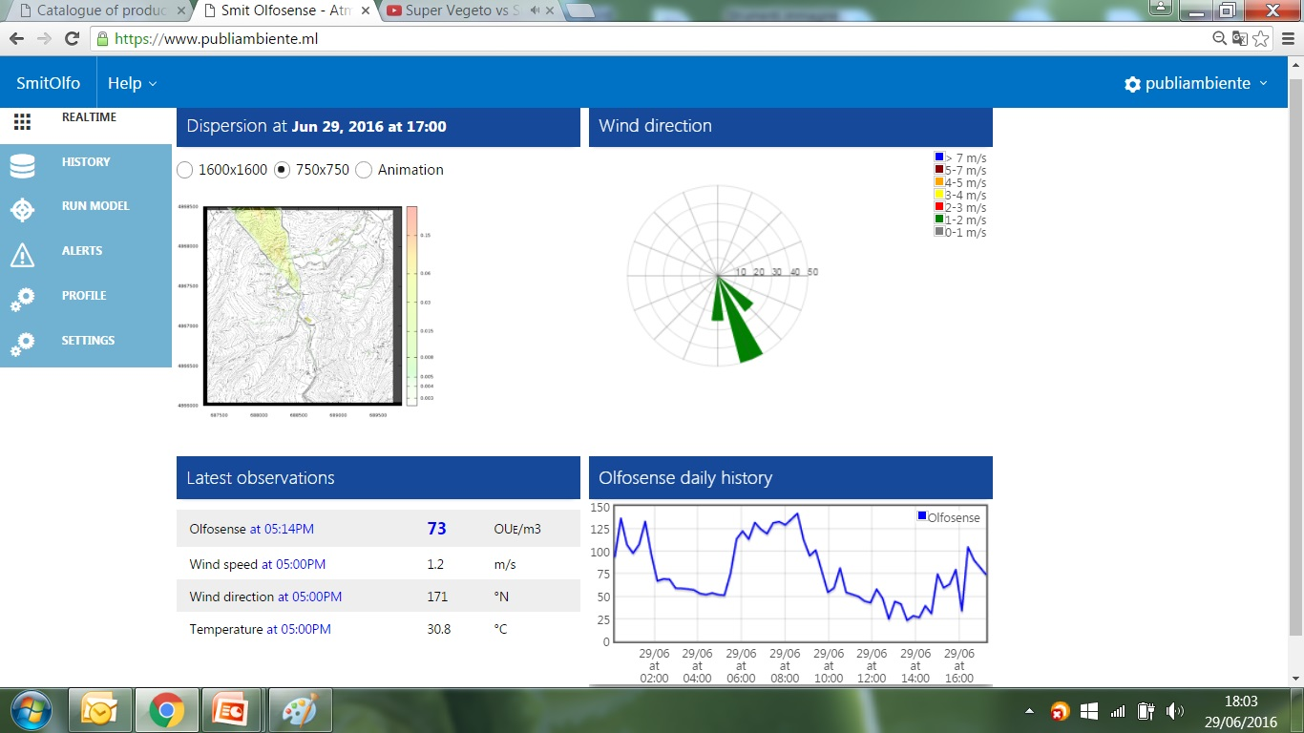
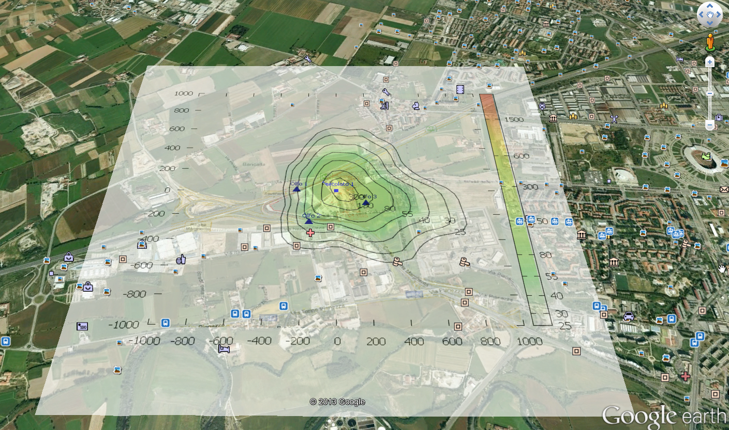

Slide 19
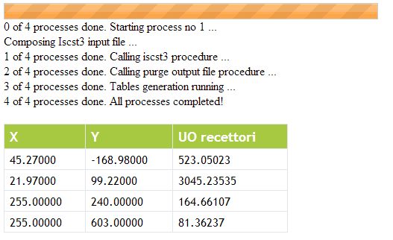


Slide 20
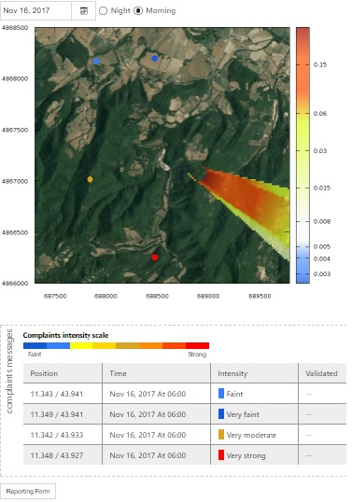
Odor complaints management

Slide 21
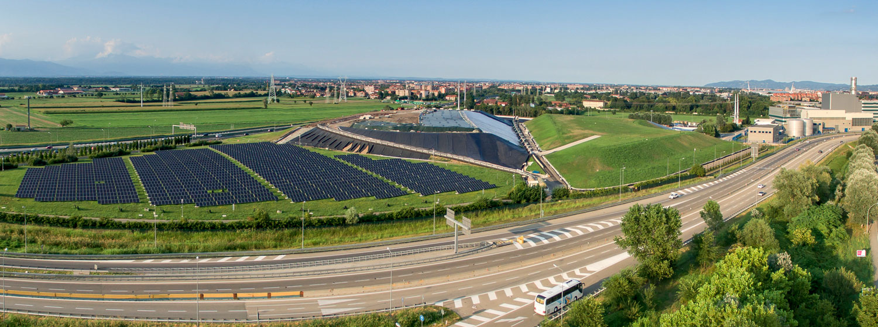
CASE HISTORY
Landfill of hazardous industrial waste
Facts
Area: 6.60 hectares
6 sensitive receptors (houses + hospital)
Horography: flat land
Next to the highway
GOALS
Odor / H₂S continuous monitoring
Dispersion plume true extent
Prompt intervention: facility staff + firefighters
OlfoSense network:
1 unit deployed on the main odor source
2 units on perimeter
1 unit at the nearest downwind receptor

Slide 22

CASE HISTORY
Petrochemical plant
Facts
Refinery area: 212 hectares
82 tanks of crude oil and finished products
1 receptor (the city - 48000 citizens)
Long-standing dispute with the community over offensive odors
GOALS
Pinpoint the main sources within the facility &
carry out plant improvements (fix up tanks covers)
Dispersion plume true extent
Prompt intervention
OlfoSense network:
4 units deployed on a few run-down tanks
2 units on downwind perimeter
1 unit in the city area

